Slide 1
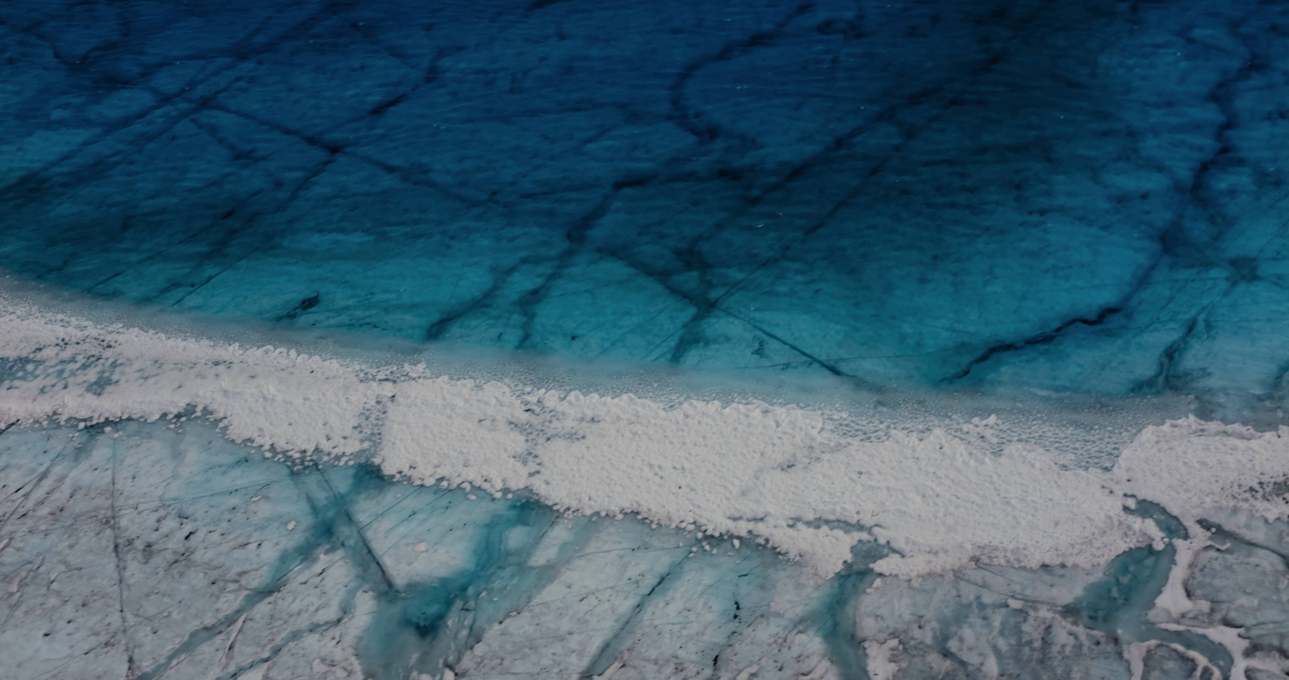
GREENLAND
MOULIN WATERLEVEL FLUCTUATION TIMESCALES
Moulin water level fluctuations
in the Greenland Ice Sheet
Celia Trunz
Dr Matthew D. Covington
Dr Jason D. Gulley
Jessica Meijia

Slide 2
GREENLAND
Background and motivation
MOULIN WATERLEVEL FLUCTUATION TIMESCALES
Nienow et al. (2017). Curr Clim Change Rep, 1–15. https://doi.org/10.1007/s40641-017-0083-9

Slide 3
GREENLAND
Model
MOULIN WATERLEVEL FLUCTUATION TIMESCALES
R = Recharge
Q = Discharge
A_{R} = Moulin section
A_{C} = Channel section
Parameter | Range
R | 1-10 m³/s
Z | 100-1000 m
r | 1-10 m
L | 100-1000 m

Slide 4
GREENLAND
Results - Timescales
MOULIN WATERLEVEL FLUCTUATION TIMESCALES
#2-decay
h
#1-oscillation
R=2m³/s
Z=1000m
r=5m
L=1000m
Dc

Slide 5
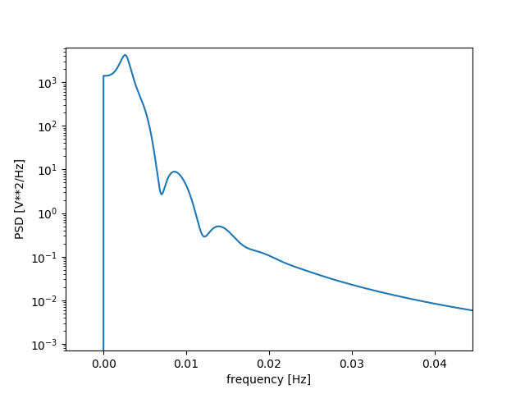
GREENLAND
Results – parameter influence
MOULIN WATERLEVEL FLUCTUATION TIMESCALES
Z = 1200 m
R=2m³/s
r=5m
L=1000m
Z = 200 m
Identifying timescales
with a Fourier transform

Slide 6
GREENLAND
Results – parameter influence
MOULIN WATERLEVEL FLUCTUATION TIMESCALES
Recharge DECREASE
[m3/s]
Radius INCREASE
Z=1000 m
Fluctuation timescale [hours]
Frequency [hours]

Slide 7
GREENLAND
Results – parameter influence
MOULIN WATERLEVEL FLUCTUATION TIMESCALES
Z=1000
Fluctuation timescale [hours]
Days

Slide 8
GREENLAND
Conclusion
MOULIN WATERLEVEL FLUCTUATION TIMESCALES
Conclusion
Thinner ice permits the system to equilibrate faster
Moving forward
Smaller recharge / Larger radius = longer time to equilibrate and wider oscillation
Simulate realistic recharge in the system
Compare output with water level measured in moulin
Equilibrium varies strongly with the variation of the parameters
Limitations
Does this set of equation represent the system?
Is the system too simplified?

Slide 9
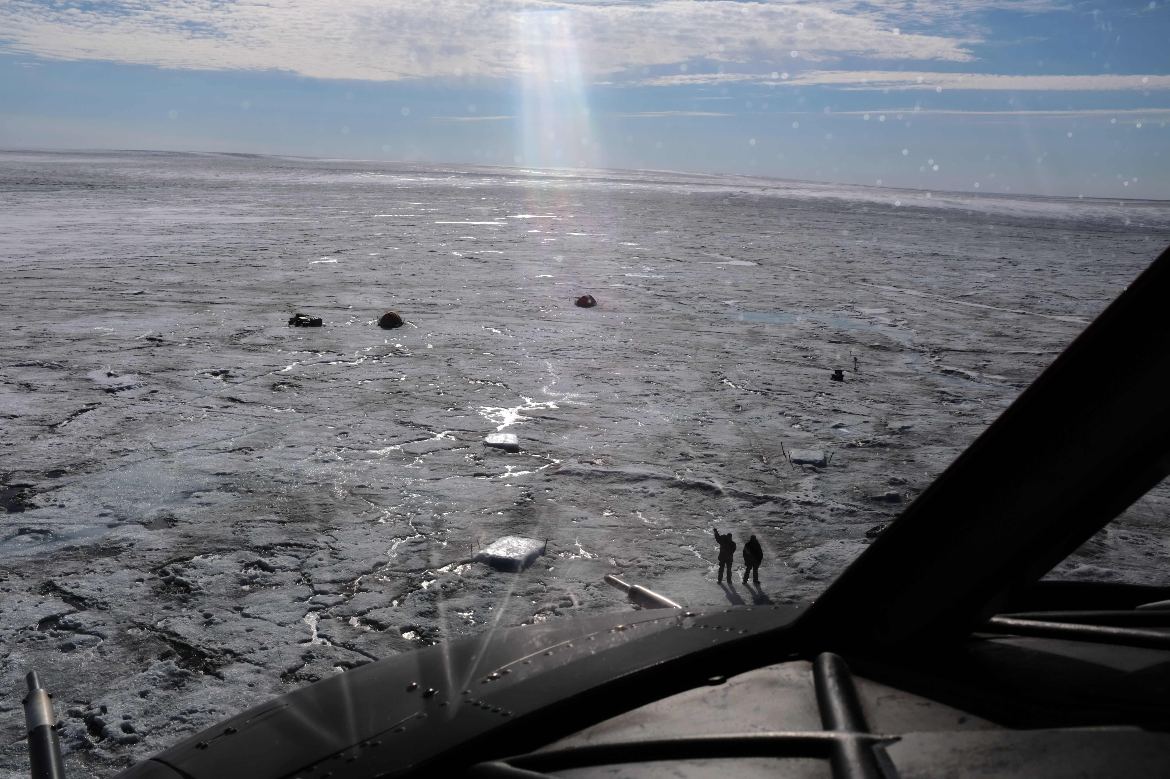
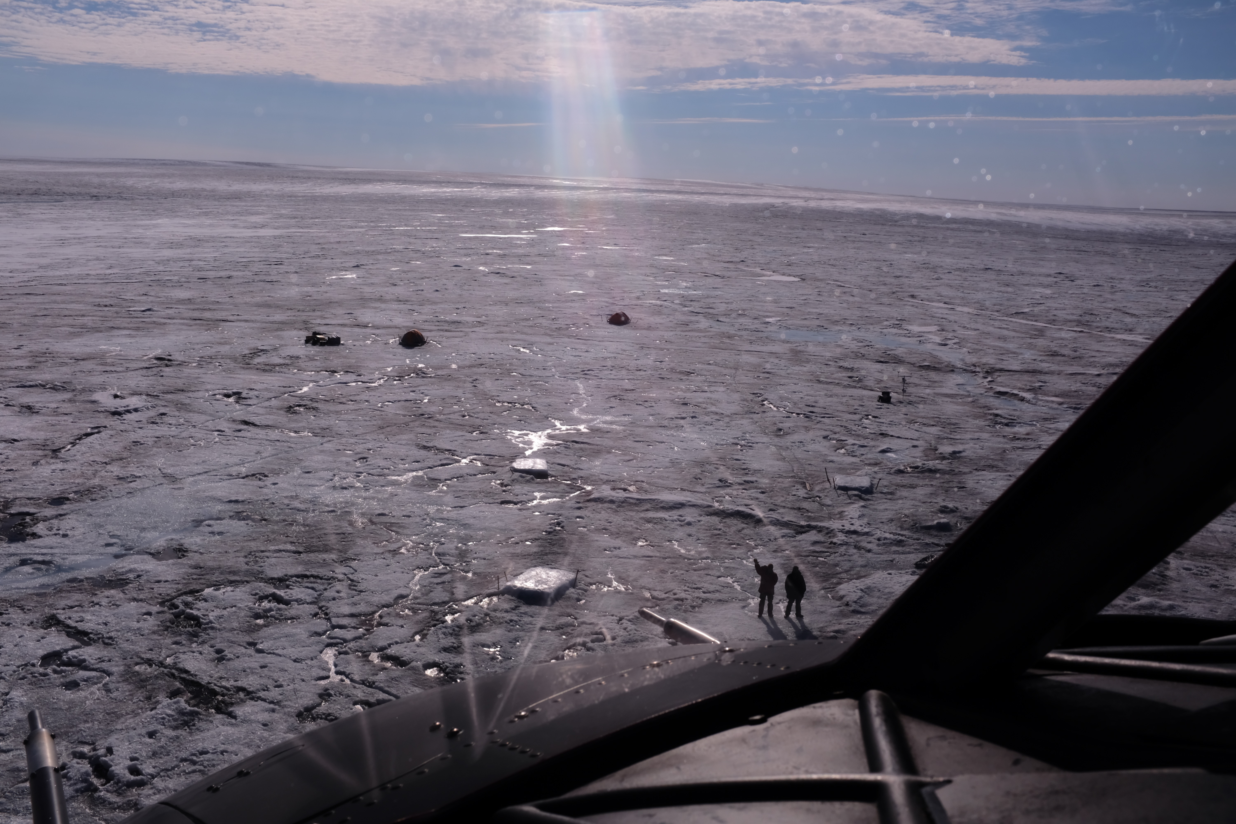
Moulin water level fluctuations
in the Greenland Ice Sheet
GREENLAND
Questions?
MOULIN WATERLEVEL FLUCTUATION TIMESCALES
THE END (or the beginning)

Slide 10
GREENLAND
Background and motivation
MOULIN WATERLEVEL FLUCTUATION TIMESCALES

Slide 11
GREENLAND
Results – parameter influence
MOULIN WATERLEVEL FLUCTUATION TIMESCALES
Recharge DECREASE
Z=200
Z=500
Z=1000
Radius INCREASE
Fluctuation timescale [hours]
Near instant equilibrium
No visible timescales

Slide 12
GREENLAND
Results – parameter influence
MOULIN WATERLEVEL FLUCTUATION TIMESCALES
Z = 1200 m
R=2m³/s
Z
r=5m
L=1000m
Z = 200 m
R=2m³/s
Z=1000m
r=5m
L

Slide 13
GREENLAND
Results – parameter influence
MOULIN WATERLEVEL FLUCTUATION TIMESCALES
R
Z=1000m
r=5m
L=1000m
R = 1 m³/s
R = 6 m³/s
r = 1 m
R=2m³/s
Z=1000m
r
L=1000m
r = 6 m

